Slide 1
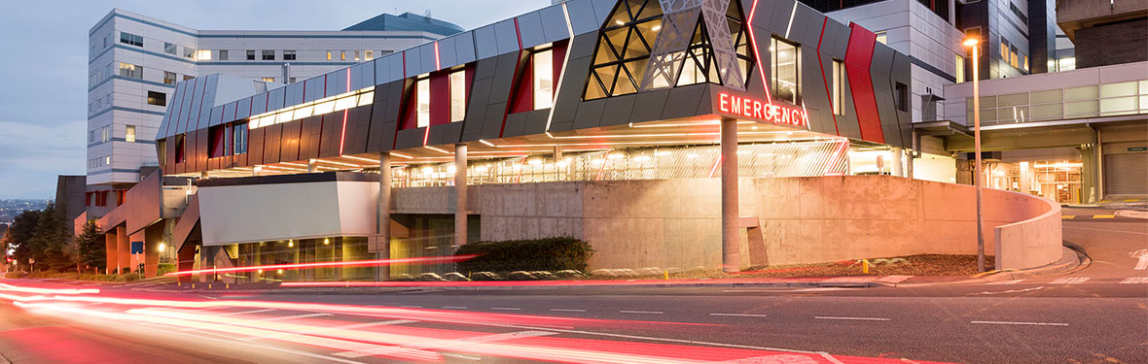
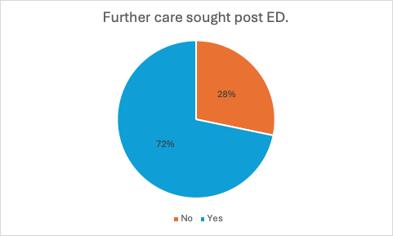
(Impact) Understanding who does not wait in the Emergency Department will inform system change
Emergency Departments (ED) patients who left without being seen (Did Not Wait).
Osman, A; Millar, R; Mansouri, N; Goh-Davis, H; Yeak, D; Ben-Meir, M; Braitberg, G.
Background: Since the COVID-19 pandemic there has been an increase in the number of patients seeking care in Emergency Departments (EDs) who leave without being seen (DNW). Internationally the DNW rate ranges from 1 to 15%. The average rate in Victoria pre-pandemic was 5-6% In September 2022, NSW reported that one in 10 patients left the ED before receiving treatment prompting the ACEM president to call this a “major safety risk”. At our institution the DNW as of March 2024 remains high, at 9%
Methods: This project uses a quantitative methods of mixed designs (retrospective audit of medical records with nested questionnaire auto-invitation using REDcap and Message Media®. Patients were contacted within 8 days of visiting the ED and recruited over 3 blocks of 2 months with an average of 550 patients per block to capture seasonal variation. Study months were Feb/March, May/June to conclude in October/November 2024.
Results
Variables | Total cohort (n=1,111) | Survey respondents n=235 (21%) | Applicable Statistical tests
Age (y) mean (SD) | 38 (21.5) | 43 (19.6) | p=0.027
Gender n (%) | Female n=586 (52.8%) Male n=524 (47.1%) Other n=1 (0.1%) | Female n=159 (67.7%) Male n=72 (30.6%) Other n=1 (0.4%) Prefer not to say n=3 (1.3%) | p<0.001
Triage Category, n (%) | ATS 2 n=90 (8.1%) ATS3 n=427 (38.4%) ATS4 n=462 (41.6%) ATS5 n=132 (11.9%) | ATS2 n=24 (10.3%) ATS3 n=100 (42.7%) ATS4 n=90 (38.5%) ATS5 n=20 (8.6%) | p=0.760
Arrival by mode | Private n=935 (84.1%) Ambulance n=173 (15.6%) Police n=3 (0.3%) | Private=210 (89.4) Ambulance=25 (10.6%) | p=0.388
EDLOS (min) mean (SD) | 203 (285) | 208 (147.4) | p=0.764
Do you have a GP? n, (%) | 1,034(93.1%) | 221 (94%) | p=0.605
Prior to presentation did you contact 1.Medical locum or 2.Nurse on Call or VVED |  | Yes, n=70 (30.0%) Yes, n= 86, (36.3%)
Do you have an after-hours GP clinic near you? n, (%) |  | Yes 53, (22.5%)
Are you a regular Austin patient? n, (%) |  | 66, (27.8%)
What is the likelihood of future use of ED? N, (%) |  | More, n=11 (4.8%) Same, n=134 (58.3%) Less, n=85 (37%)
Study participants were similar to the overall population (see table). 72% patients sought follow up care, 64% from a medical practitioner and 16% presented to another hospital, mostly to another Emergency Department
Limitations: The survey was conducted in English and 98% of our respondents indicated they were comfortable with their level of English. Hence the sample may have been biased towards English speakers. A response rate of 22%, given the nature of the study, was considered to be a good outcome.
Conclusion: This study showed that patients who DNW did so during times of high activity, had a prolonged wait of over 3 hours, and presented with higher acuity than previously documented (~50% ATS 2 and 3). Most patients (72%) required follow up care. High levels of DNW are likely to lead to adverse patient outcomes.
Leeroy Jenkins, Shuri Wright, Emmett Brown

